Slide 1
Placement Coordination System

Slide 2
Introduction
PCS Aims to create an easier automated fashion of companies approaching colleges as well as allotting students to particular placement programs based on company requirements.
Requires minimal manual effort and paperwork
our application helps companies register at college with ease and matches up students they are seeking to attend the placement program

Slide 3
Abstract
The placement coordination system simplifies the process of conducting a placement or job fair program in a college.
It is helpful for students to receive notification on placement events that they could attend based on their performance and companies posting details.
The system not only focuses on students registered but also on companies interested in offering a campus placement drive in a college.
The company can register then set posting details, required candidate type, job category etc... and receive an automatically filtered group of students that match their needs to be attending their program.
Our newly proposed system decreases manual work load for registering students, notifying users, companies contacting college authorities etc...

Slide 4
Disadvantage of existing system
Requires several paper works (eg: registration forms filled by students)
difficult for students to choose and manage between placement events they should attend
requires more staff or students to be involved in volunteering and managing a placement event
companies has to go through unwanted candidates attending event
less companies has knowledge of a placement event happening in a particular college

Slide 5
Advantages of proposed system
Decrease workload on Placement Coordinator.
Can attract more candidates(students) to attend the program from in or out of campus due to ease of registering and notification feature.
can conduct placement event all year long providing more opportunities for students.
filters right candidates required for company as well as providing only notifications on events the student is capable of attending.
more companies will participate without much advertising cost

Slide 6
Modules
Student:
registers as new user
logs in using username and password
can edit details
can view notification
Company:
logs in using username and password
can register to conduct a placement event
if approved by admin , can add a job posting required criteria for attending event etc...
can edit details
can view status on students capable of attending the program, verification status and receive admin messages
placement coordinator(ADMIN):
logs in
verifies registered companies if they are valid or not
provides special notifications, messages to students or companies

Slide 7
Hardware Software Requirements
Hardware:
Processor: 64bit processor
Ram: min 8GB
Hard disk: 1TB
Software:
OS: windows 7 or above
Front end: python
Back end: mysql server
Framework: Django
IDE : pycharm
Tools: html ,css

Slide 8
Usecase Diagram
:Placement Coordination system
Home
Registration
Edit
Placement Coordinator
View
Verify
Notification
Company
Add Vacancy
Student

Slide 9
Scenario
Placement Coordinator :
View registered Companies and Verify
Send Notification to Students and company
Company :
Registration
Add Vacancy
View filtered students
View Notification from placement coordinator
Edit profile

Slide 10
Student :
Registration
Edit profile
View Notification

Slide 11
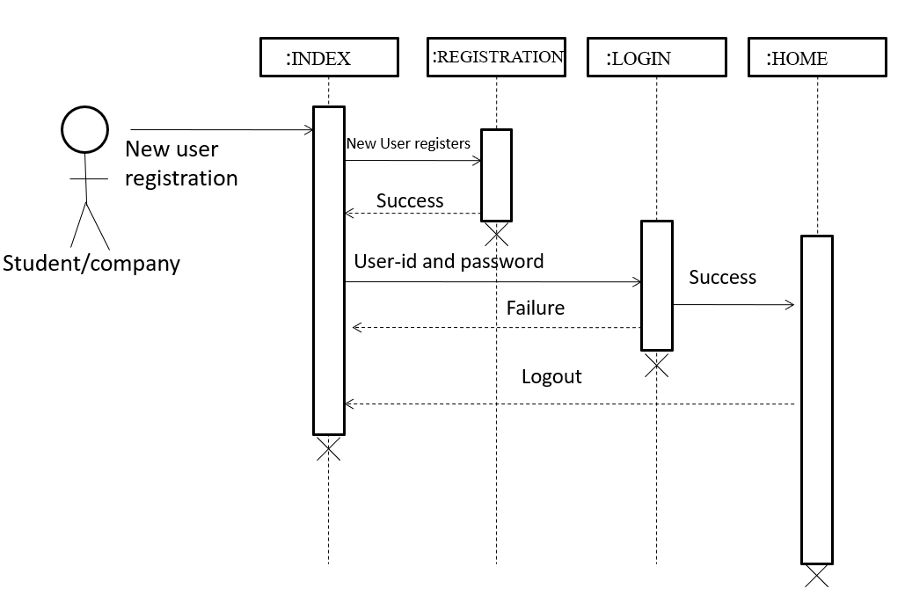
Sequence diagram Registration

Slide 12
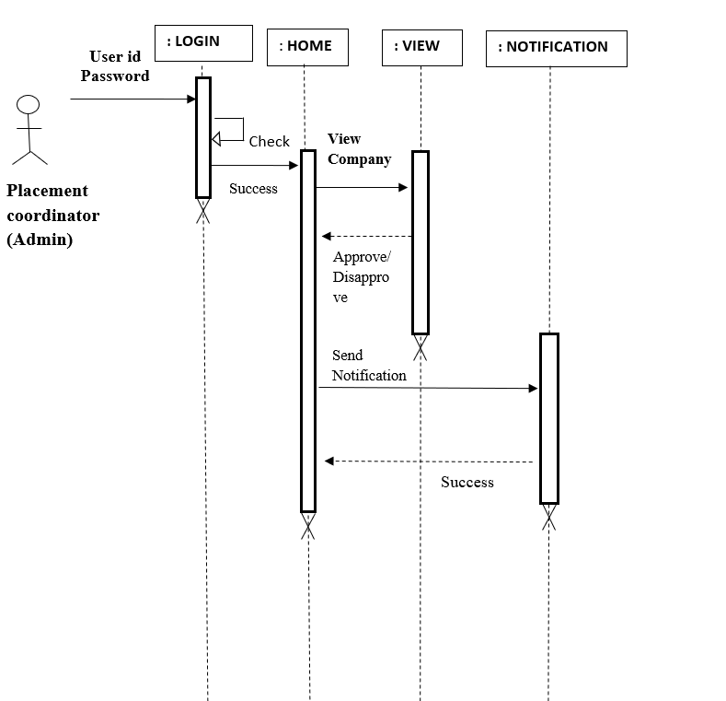
Placement coordinator

Slide 13
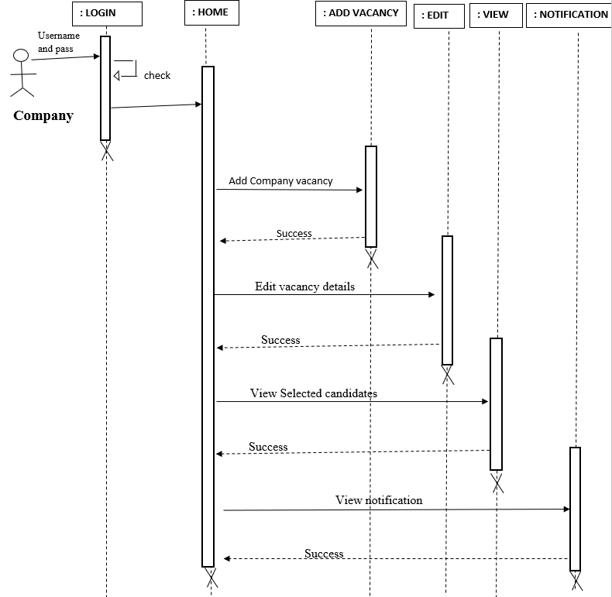
company

Slide 14
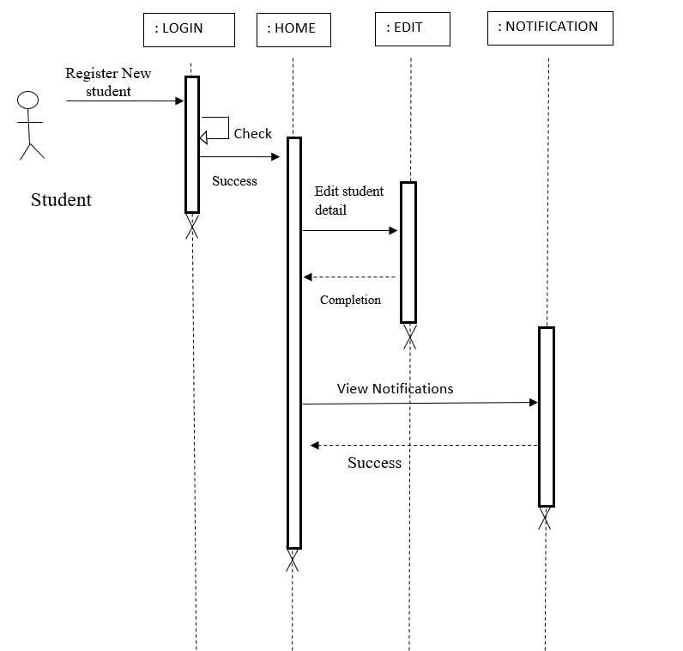
student

Slide 15
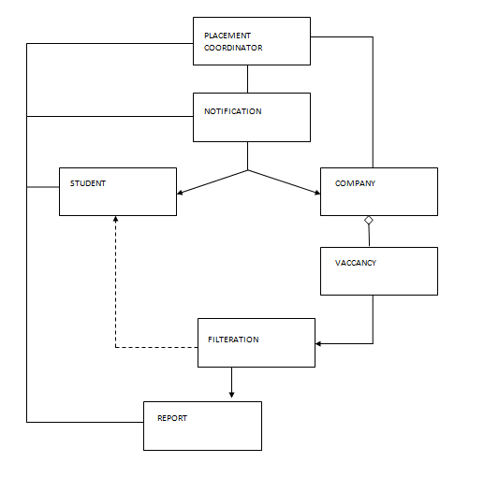
Class diagram

Slide 16
Database
Table name: login
Column name | Data type | Description
id | Int(11) | Primary key
username | varchar (20) | username
password | varchar (20) | password
logintype | varchar (20) | Type of login

Slide 17
Table name: stregistration
Column name | Data type | Description
stid | Int | Primary key
sfirstname | varchar (12) | First name of student
smiddlename | varchar (12) | Middle name of student
slastname | Varchar(12) | Last name of student
smail | varchar (35) | Mail id of student
snumber | bigint (20) | Phone number of student
sgender | varchar (20) | Gender of student
snationality | Varchar(20) | Nationality of student
smartial | Varchar(12) | If student Married or not
slanguage | Varchar(80) | Languages known by student
stimg | Varchar(80) | Name of Photo of student
studsign | Varchar(80) | Signature of student filename
squalification | Varchar(80) | Qualification of student
sskills | Varchar(80) | Skills attained by student
studexperience | Varchar(80) | Job experience of student
login_idd_id | Int(11) | Foreign key

Slide 18
Table name: cmpregistration
Column name | Data type | Description
cmid | int(11) | Primary key
cname | varchar (30) | Name of company
caddress | varchar (60) | Address of company
ccity | varchar (20) | City company is placed in
cstate | varchar (20) | State company is placed in
ccmpno | varchar (20) | Phone number of company
cemail | varchar (30) | Email id of company
ccontactname | varchar (20) | Person of contact in company
ctitle | varchar (20) | Title of the contact person
login_id_id | int(11) | Foreign key

Slide 19
Table name: cmvaccancy
Column name | Data type | Description
cmid | Int | Primary key
cmtitle | varchar(20) | Job title
cmlocation | varchar (25) | Location of work
cmjobtype | varchar (20) | Type of job
cmsalary | Int (11) | Salary offered
cmworkinghrs | varchar(10) | Working hours of job
cmqualification | varchar(60) | Qualification required
cmbranch | varchar(300) | Branch’s needed
cmperccentage | varchar(20) | Percentage of marks required
cmyearofpass | varchar(25) | Year the student have graduated
cmbacklogs | varchar(25) | No of max backlogs
cmage | varchar(25) | Age of students required
cmgender | varchar(7) | Gender of student
cmmartial | varchar(10) | Martial status of student
cmexperience | varchar(20) | Job experience the student have

Slide 20
cmlanguage1 | varchar(60) | A preferred language
cmlanguage2 | varchar(60) | Secondary preferred language
cmreqdocs | varchar(100) | Documents the student should have
cmdate | varchar(30) | Date of conducting the event
cmtime | varchar(10) | Time of conducting event
cmv_idd_id | int(11) | Foreign key

Slide 21
Table name: education
Column name | Data type | Description
eid | Int (11) | Primary key
course | varchar(50) | Course taken by student
branch | varchar (50) | The branch of course the student belongs to
yearofpass | varchar (40) | Year student has graduated
backlog | varchar (40) | Number of backlogs student has
percentage | varchar (40) | The percentage of final marks
sid_id | Int (11) | Foreign key

Slide 22
Table name: notification
Column name | Data type | Description
adid | Int (11) | Primary key
adnotification | varchar(20) | The message to be passed
sendto | varchar (20) | The intended user type to send to
date | varchar (20) | Date the message was send

Slide 23
Table name: filtered
Column name | Data type | Description
fid | Int (11) | Primary key
cmidd_id | Int (11) | Foreign key
stidd_id | Int (11) | Foreign key

Slide 24
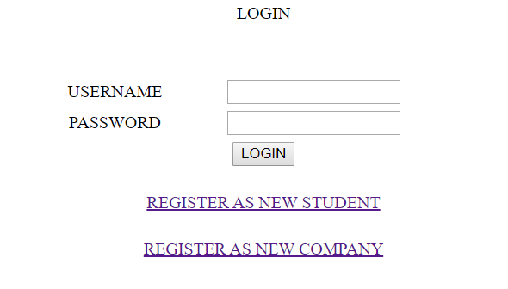
Form1 :login

Slide 25
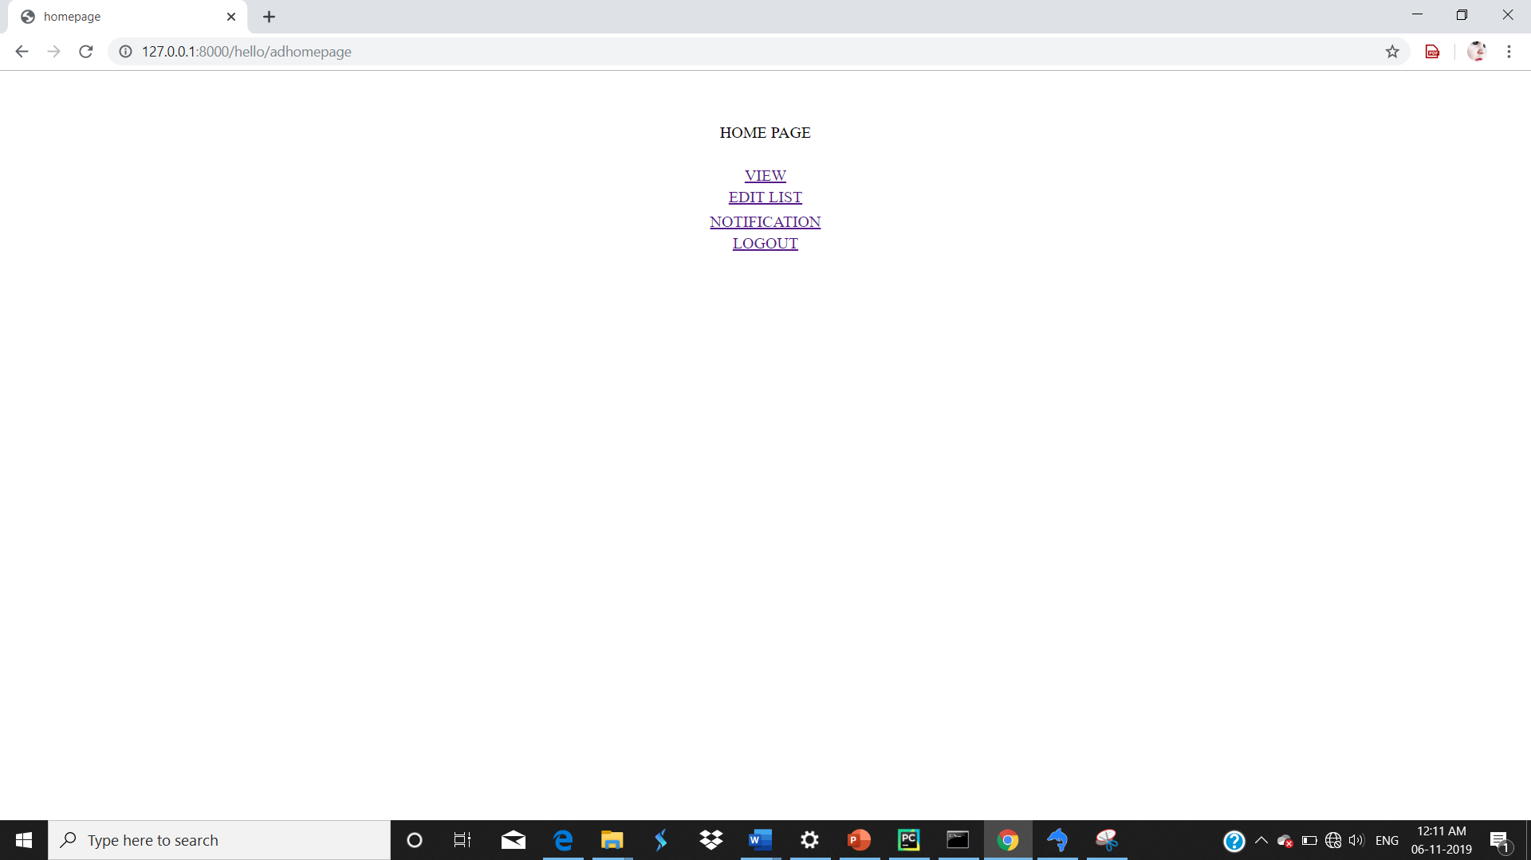
Form2 :Adminhome

Slide 26
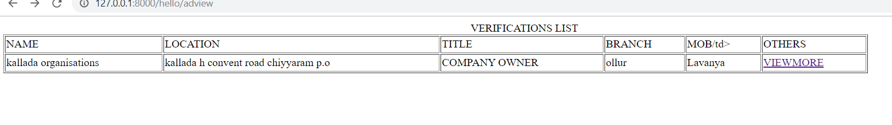
Form3 :Admin view and verify

Slide 27
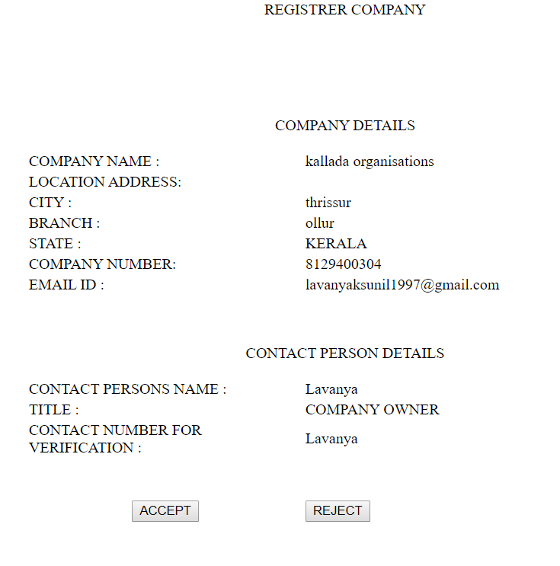

Slide 28
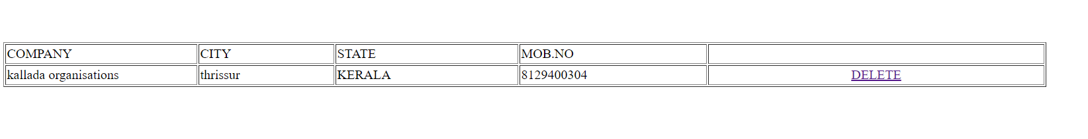
Form4:Admin edit

Slide 29
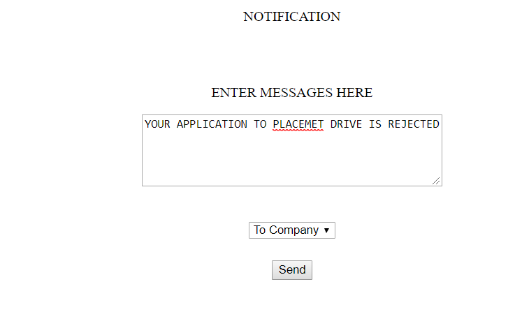
Form4:Notification

Slide 30
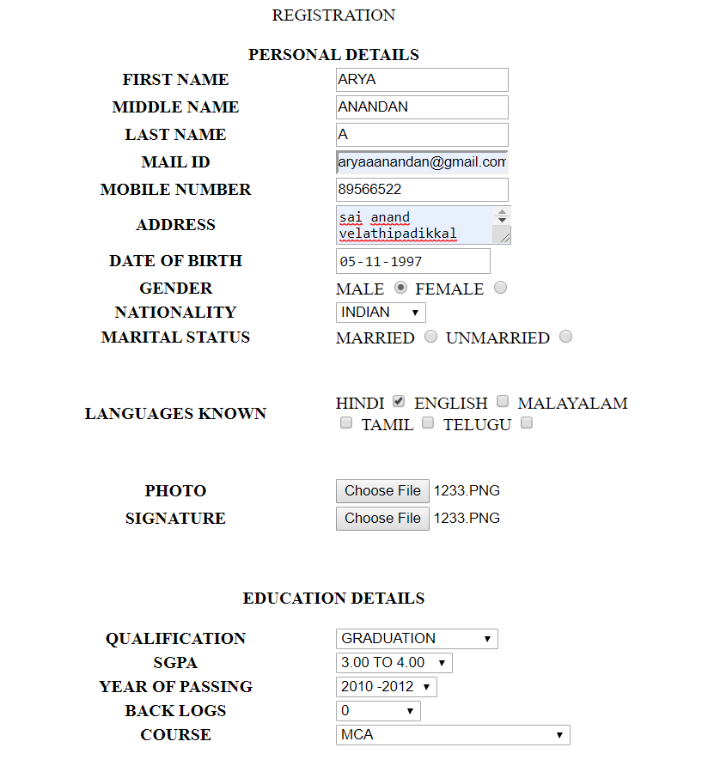
Form5:stud registration

Slide 31
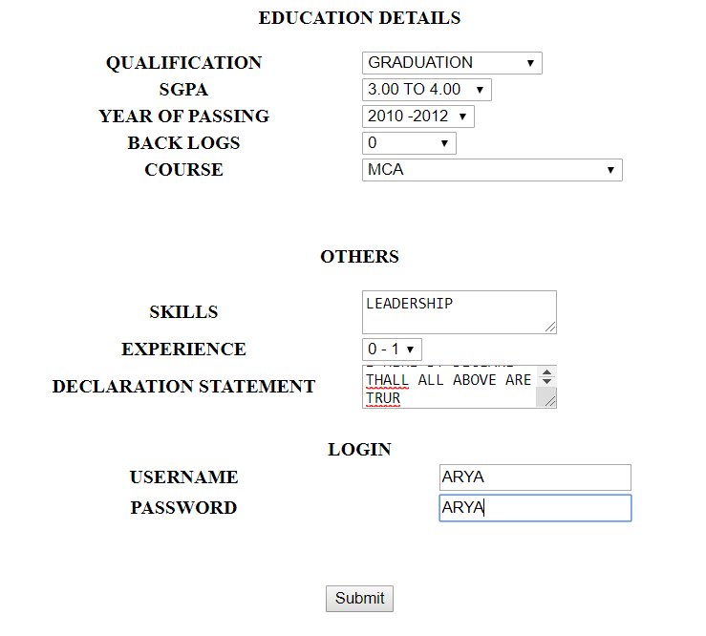

Slide 32
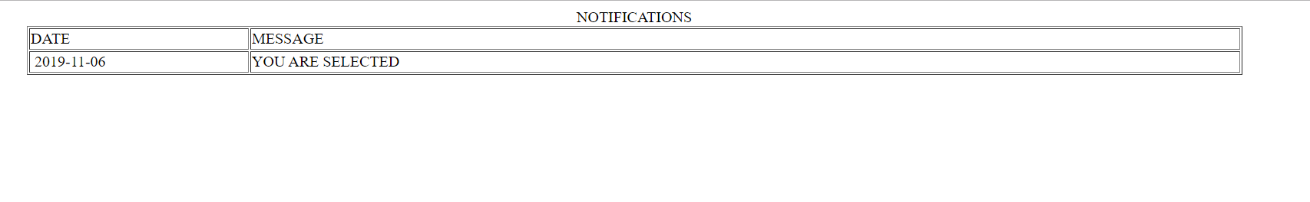
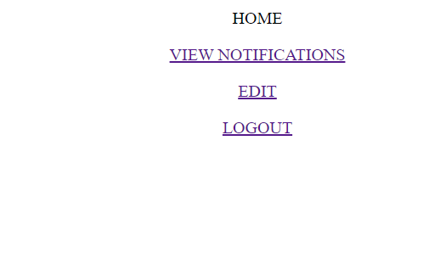
Form6:stud view notification
Form7:studhome

Slide 33
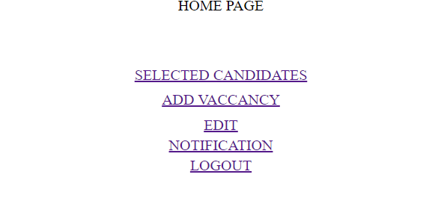
Form8:companyhomepage

Slide 34
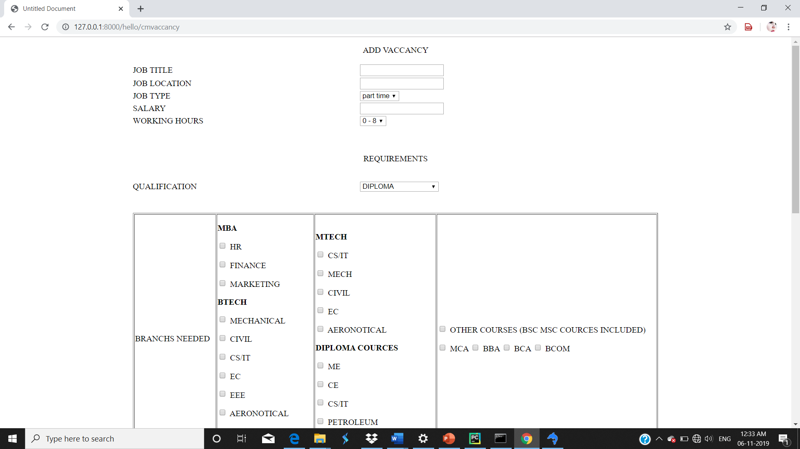
Form9:add vaccancy

Slide 35
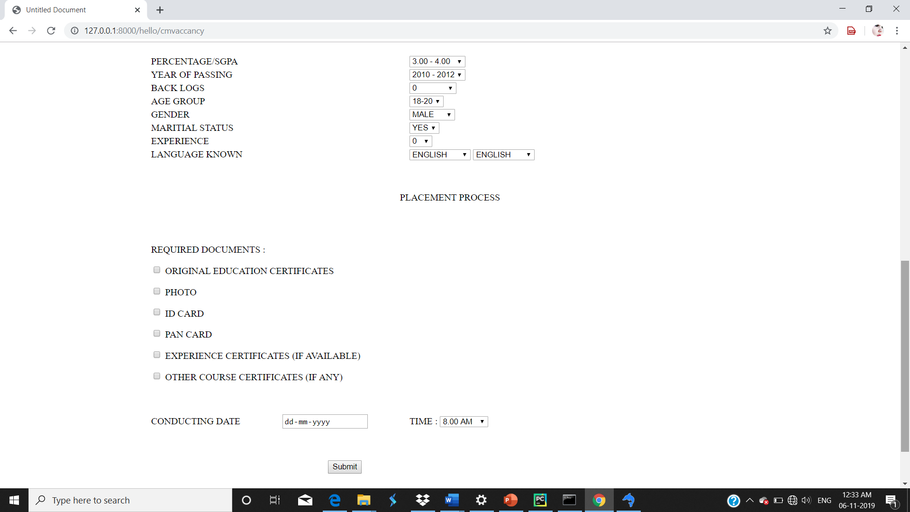

Slide 36
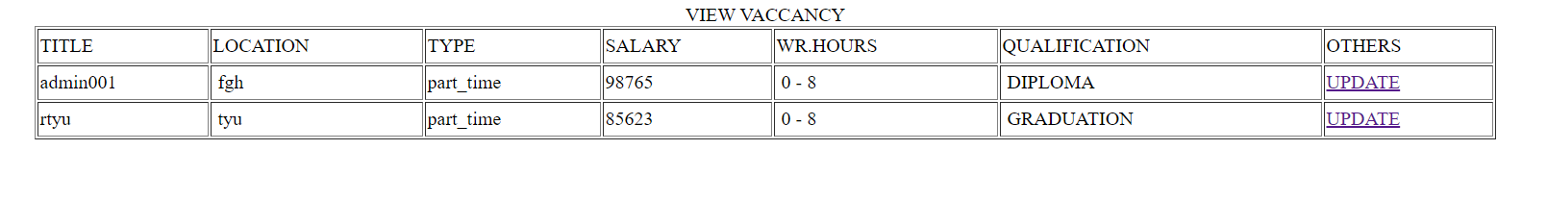
Form10:view and update

Slide 37
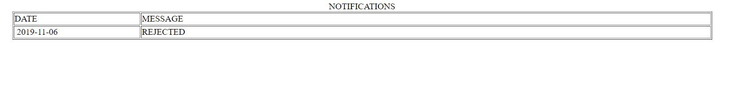
Form10:company view notifiacation

Slide 38
Sprint
Module | Task | Pending Task | Hour for completion | Expected Date for completion | Actual Date for completion | Reason for Deviation
Placement Coordinator | Form Design | = | 8hrs | 06-10-19 | 28-8-19 | =
 | Database Design | = | 6hrs | 06-10-19 | 25-9-19 | =
 | Linking to pages and query functions | = | 6hrs | 06-10-19 | 28-9-19 | =
 | Defining functions | = | 8hrs | 06-10-19 | 6-10-19 | =
 | Notification | = | 2hrs | 06-10-19 | 13-10-19 | Small task

Slide 39
Module | Task | Pending Task | Hour for completion | Expected Date for completion | Actual Date for completion | Reason for Deviation
Student | Form Design | = | 8hrs | 20-10-19 | 28-8-19 | =
 | Database Design | = | 8hrs | 20-10-19 | 9-10-19 | =
 | Linking to pages and query functions | = | 8hrs | 20-10-19 | 9-10-19 | =
 | Filtered Notifications | = | 6hrs | 20-10-19 | 20-11-19 | Lack of time

Slide 40
Module | Task | Pending Task | Hour for completion | Expected Date for completion | Actual Date for completion | Reason for Deviation
Company | Form Design | = | 7hrs | 30-10-19 | 9-10-19 | =
 | Database Design | = | 10hrs | 30-10-19 | 30-10-19 | =
 | Linking to pages and query functions | = | 3hrs | 30-10-19 | 16-10-19 | =
 | Defining functions | = | 5hrs | 30-10-19 | 30-10-19 | =
 | Add vacancy to filtering | = | 5hrs | 13-11-19 | 20-11-19 | Lack of time

Slide 41
Thank you

